Slide 1
ECEG-5193: Algorithm Analysis and Design
Analysis of Sorting and Searching algorithms
2-3 Trees
van Emde Boas Trees

Slide 2
2-3 Trees

Slide 3
2-3 Trees
Properties 2-3 Trees are balanced search trees.
Every node with children (non-leaf) has
either two children (2-node) and consists of one piece of data, or
has three children (3-node) and consists of 2 pieces of data.

Slide 4
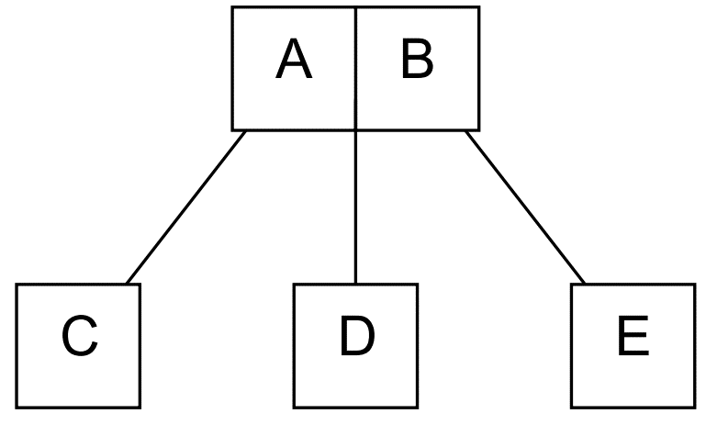
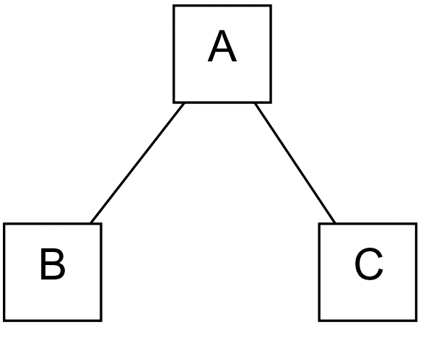
2-3 Trees
3-Node
Every non-leaf is a 2-node or 3-node
All leaves are at the same level
All non-leaves branch
All data is kept in sorted order
Every leaf node will contain one or two fields
Height ≤ lgn (More dense than BST)
2-Node

Slide 5
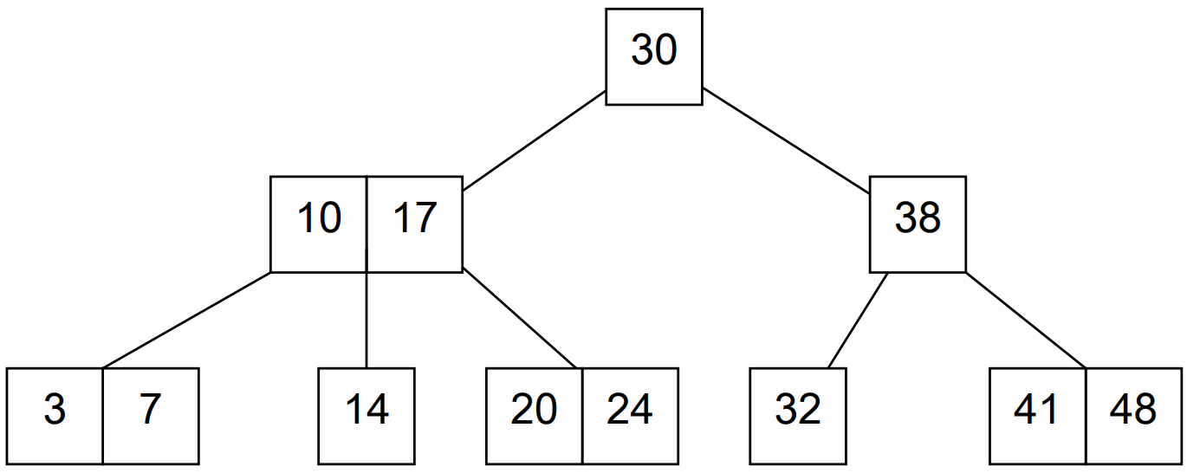
Example 2-3 Tree

Slide 6
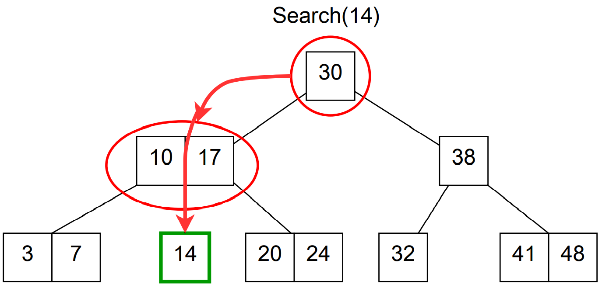
2-3 Tree - Search
Very similar to Binary Search.
Start at the root node, and traverse down tree in order.
Tree is sorted so only need to look at one node for each level of tree.
Search runtime is O(lg(n))

Slide 7
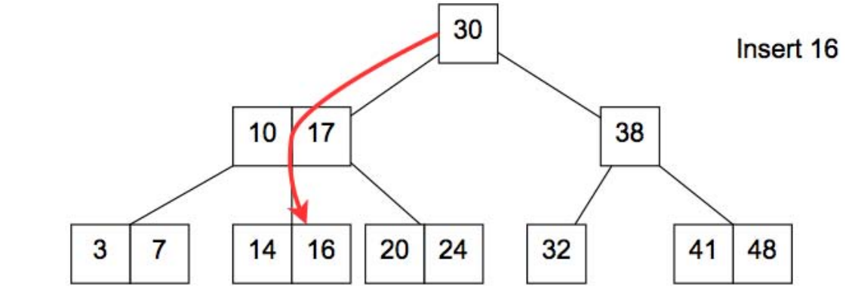
2-3 Tree – Insert Example

Slide 8
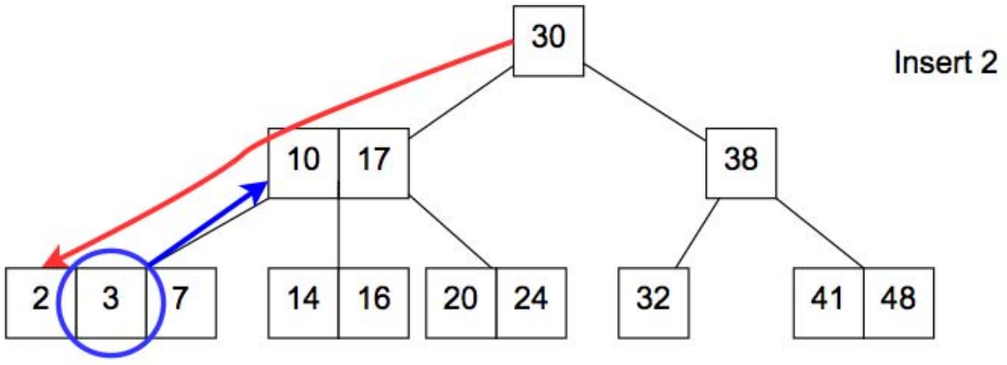
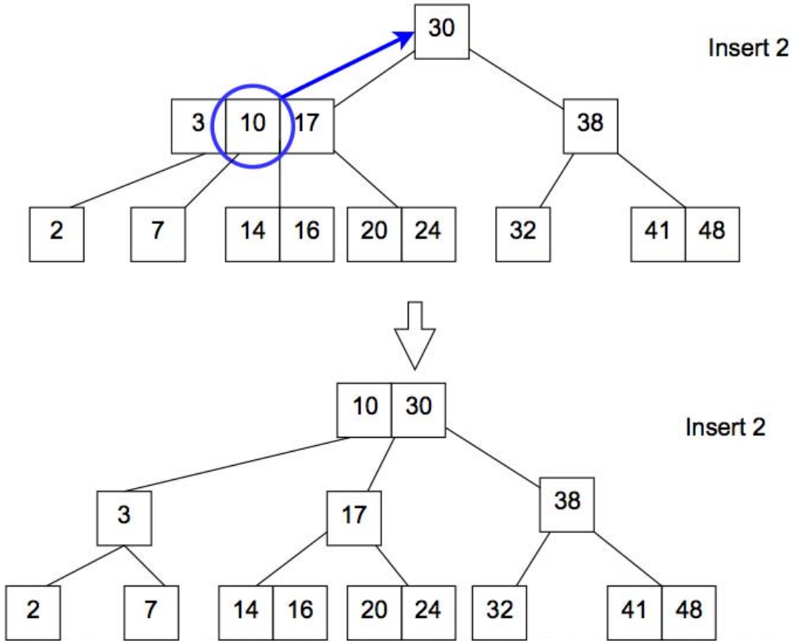
2-3 Tree – Insert Example

Slide 9
2-3 Tree – Delete
Delete(X) Steps:
Swap item to delete with inorder successor if item is not already a leaf.
Redistribute and merge nodes if there is underflowing in order to get back to a correct 2-3 tree
Runtime is O(lg(n))

Slide 10
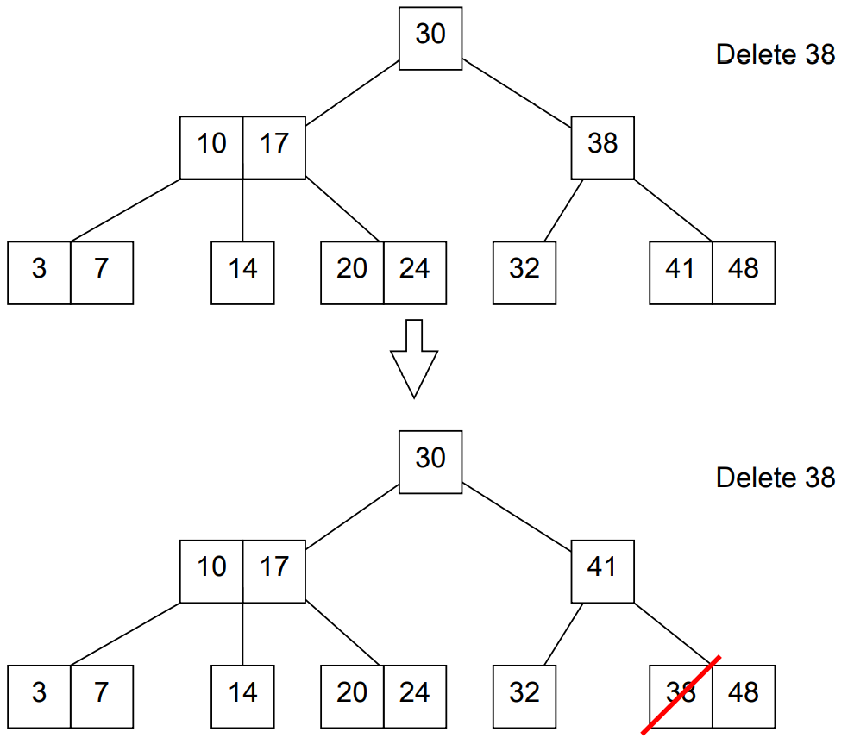
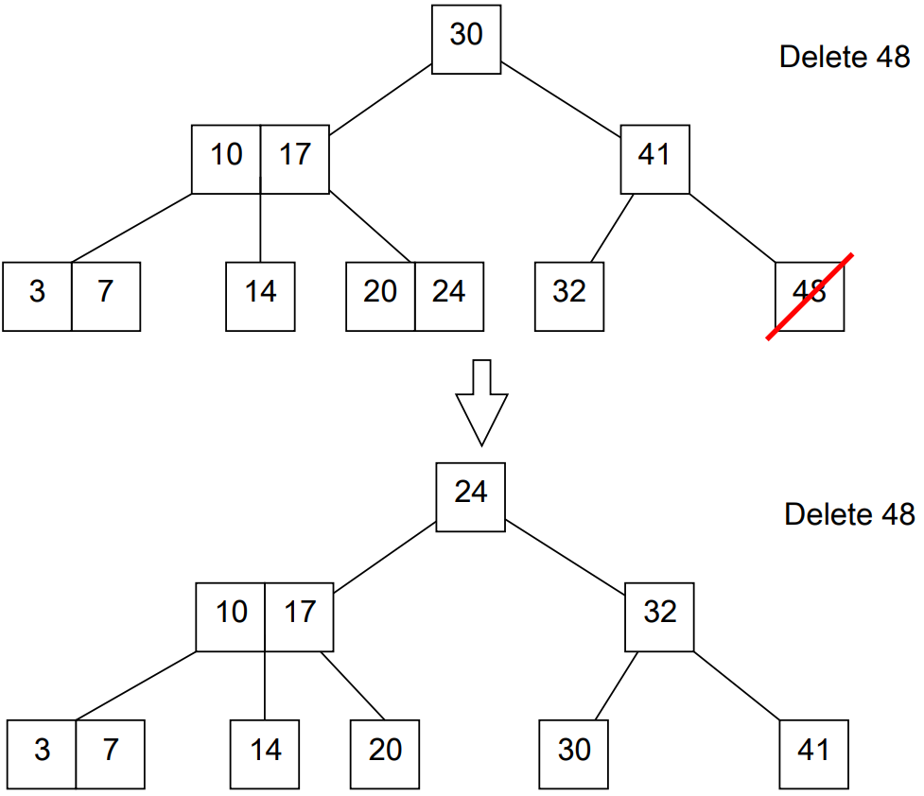
2-3 Tree – Delete: Redistribute Example

Slide 11
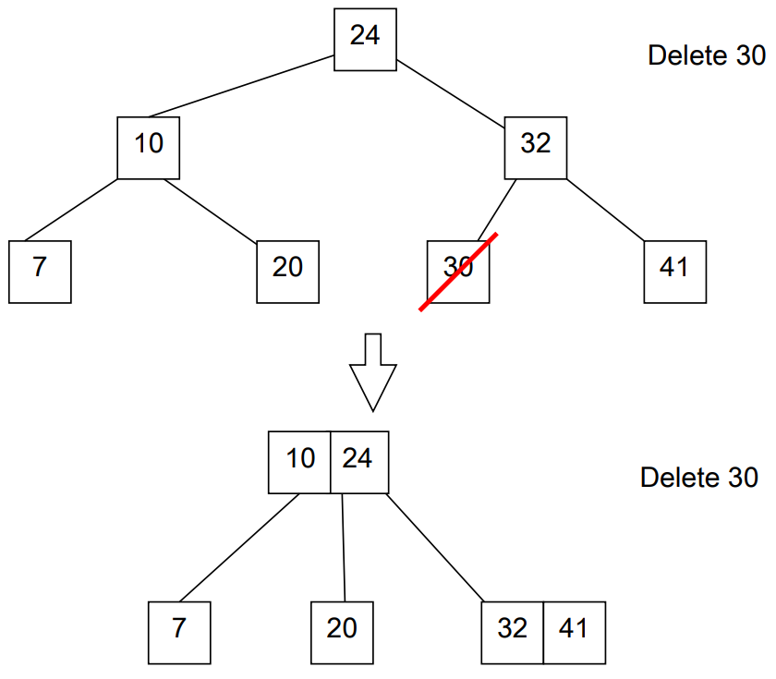
2-3 Tree – Delete: Merge Example

Slide 12
B-Trees
A B-tree has a parameter called the minimum degree or branching factor.
For the purposes of our discussion let the branching factor be B.
For any non leaf node, the number of children is one greater than the number of keys in that node.
Every non-root node contains at least B − 1 keys.
Consequently, all internal (non-leaf and non-root) nodes have at least B children.
Every node contains at most 2B −1 keys.
Consequently, all nodes have at most 2B children.
All the leaves are at the same depth.

Slide 13
Why B-Trees
Caches read whole blocks of data, and want entire block useful
Set parameter B equal to block size
O(log_{b}(n)) block reads per Search, Insert, Delete operations.
B-Trees are used by most databases and filesystems:
Databases: Sleepycat/BerkelyDB, MySQL, SQLite -Filesystems: MacOS HFS/HFS+, ReiserFS, Windows NTFS, Linux ext3, shmfs

Slide 14
Divide and Conquer van Emde Boas Trees

Slide 15
van Emde Boas Trees
Goal
We want to maintain n elements in the range {0, 1, 2, . . . , u − 1} and perform
Insert,
Delete and
Successor operations in O(log log u) time
Application: Network Routing Tables
u = Range of IP Addresses → port to send (u = 2³² in IPv4)

Slide 16
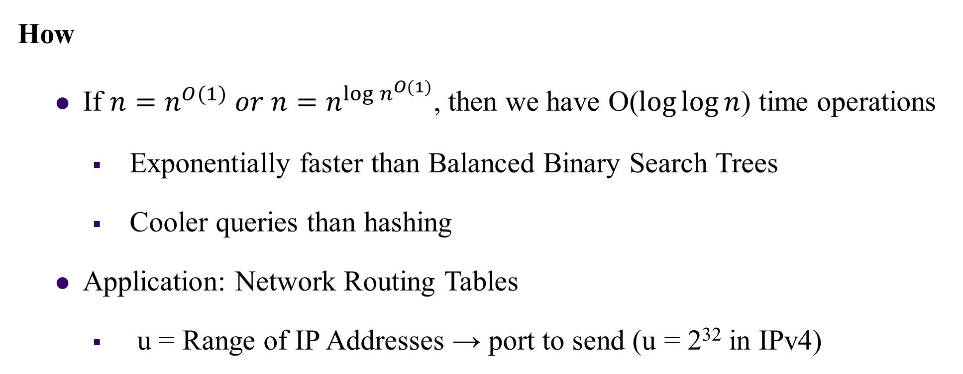
van Emde Boas Trees
How
If $n=n^{O(1)} or n=n^{{\log{n}}^{O(1)}}$, then we have O($\log{\log{n}}$) time operations
Exponentially faster than Balanced Binary Search Trees
Cooler queries than hashing
Application: Network Routing Tables
u = Range of IP Addresses → port to send (u = 2³² in IPv4)

Slide 17
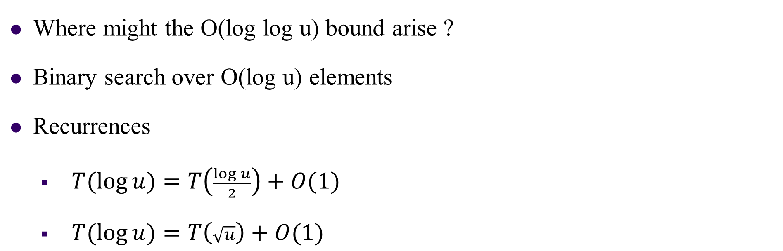
van Emde Boas Trees
Where might the O(log log u) bound arise ?
Binary search over O(log u) elements
Recurrences
$T(\log{u)=T\left(\frac{\log{u}}{2}\right)+O(1)}$
$T(\log{u)=T\left(\sqrt{u}\right)+O(1)}$
Improvements
We will develop the van Emde Boas data structure by a series of improvements on a very simple data structure

Slide 18
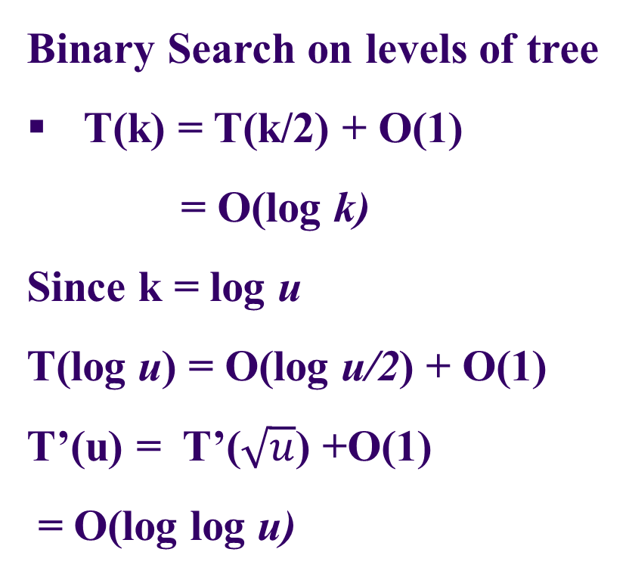
van Emde Boas Trees
Binary Search on levels of tree
T(k) = T(k/2) + O(1)
= O(log k)
Since k = log u
T(log u) = O(log u/2) + O(1)
T’(u) = T’($\sqrt{u}$) +O(1)
= O(log log u)
log u
u
What DS is suitable for constant time Insert and delete?

Slide 19
1. Bit Vector
We maintain a vector V of size u such that V[x] = 1 if and only if x is in the set. Now, inserts and deletes can be performed by just flipping the corresponding bit in the vector. However, successor/predecessor requires us to traverse through the vector to find the next 1-bit.
Insert/Delete: O(1)
Successor/Predecessor: O(u)
Bit vector for u = 16. The current set is {1, 9, 10, 15}.

Slide 20
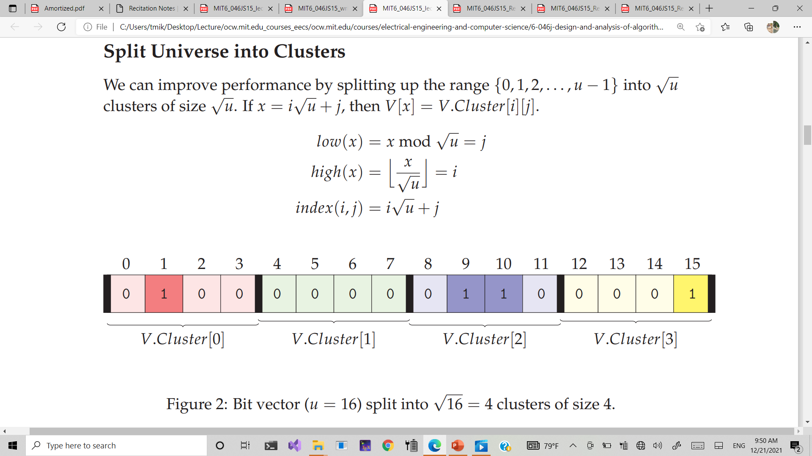
2. Split Universe into Clusters
We need to store both the bit vector and the summary vector
Summary Vector
1
0
1
1
OR
OR
OR
OR
1
0
0
0
1
1
0
1
OR
OR
OR
OR
OR
OR
OR
OR

Slide 21
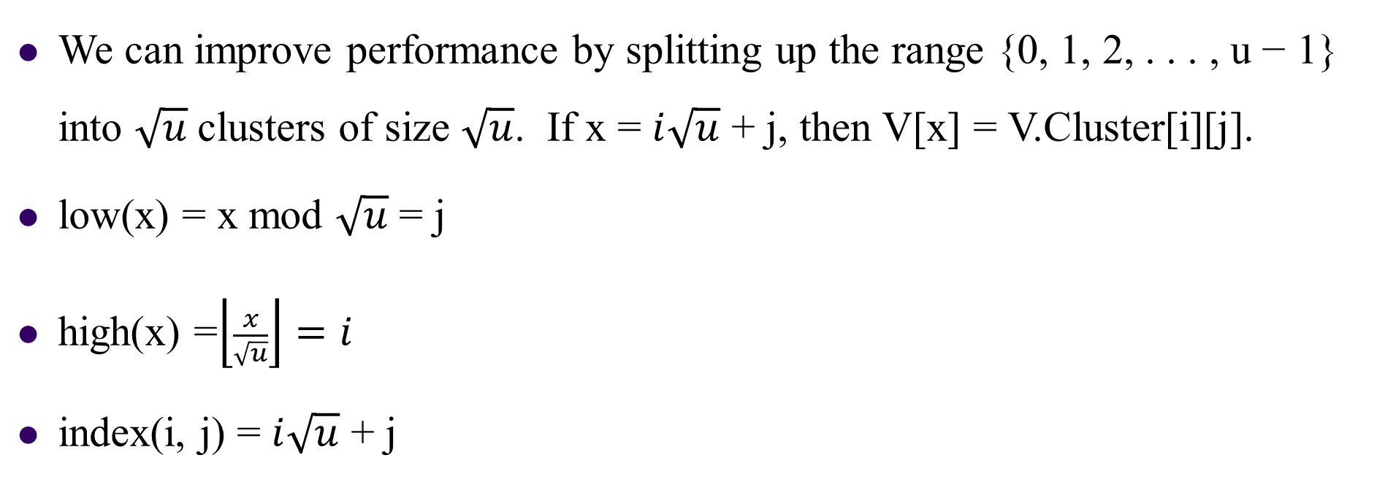
Split Universe into Clusters
We can improve performance by splitting up the range {0, 1, 2, . . . , u − 1} into $\sqrt{u}$clusters of size $\sqrt{u}$. If x = $i\sqrt{u}$ + j, then V[x] = V.Cluster[i][j].
low(x) = x mod $\sqrt{u}$ = j
high(x) =$\left\lfloor \frac{x}{\sqrt{u}}\right\rfloor =i$
index(i, j) = $i\sqrt{u}$ + j
Bit vector (u = 16) split into $\sqrt{16}$ = 4 clusters of size 4

Slide 22
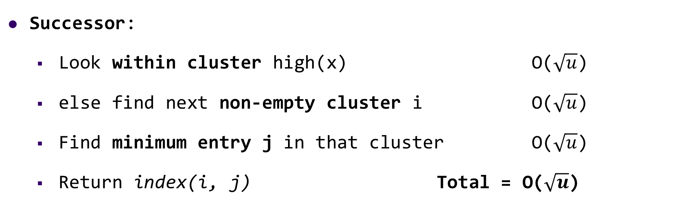
Insert
Insert
Set V.cluster[high(x)][low(x)] = 1 O(1)
Mark cluster high(x) as non-empty O(1)
Successor:
Look within cluster high(x) O($\sqrt{u}$)
else find next non-empty cluster i O($\sqrt{u}$)
Find minimum entry j in that cluster O($\sqrt{u}$)
Return index(i, j) Total = O($\sqrt{u}$)

Slide 23
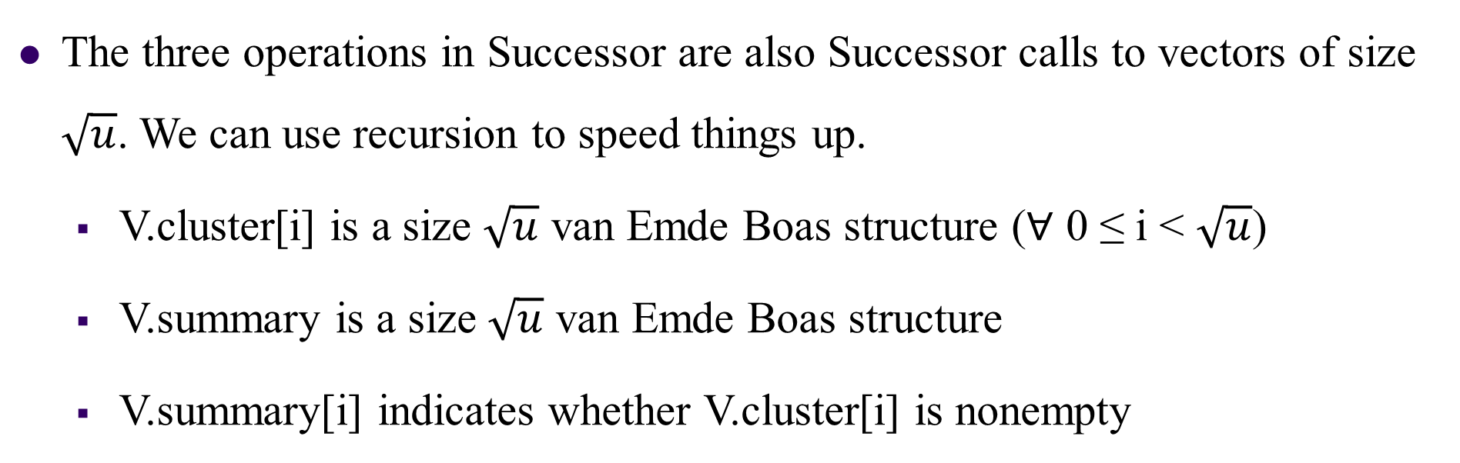
3. Recurse
The three operations in Successor are also Successor calls to vectors of size $\sqrt{u}$. We can use recursion to speed things up.
V.cluster[i] is a size $\sqrt{u}$ van Emde Boas structure (∀ 0 ≤ i < $\sqrt{u}$)
V.summary is a size $\sqrt{u}$ van Emde Boas structure
V.summary[i] indicates whether V.cluster[i] is nonempty

Slide 24
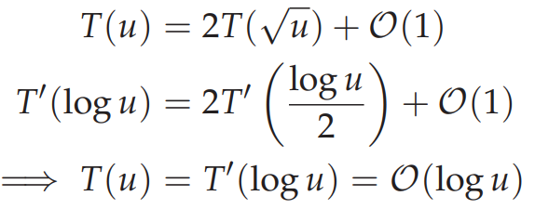
INSERT
INSERT(V, x)
1 Insert(V.cluster[high(x)], low[x])
2 Insert(V.summary, high[x])
So, we get the recurrence:

Slide 25
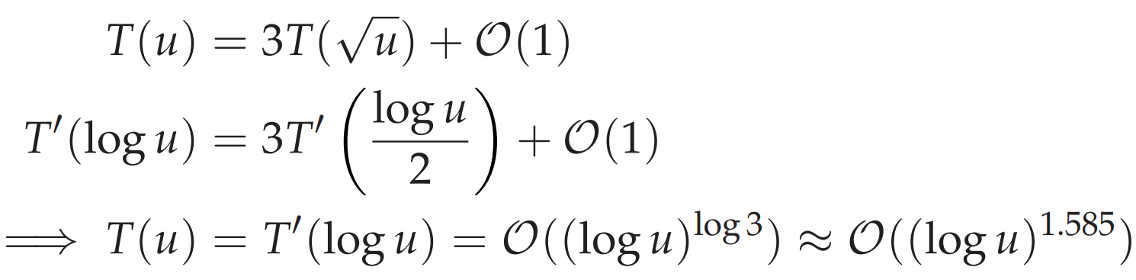
SUCCESSOR
SUCCESSOR(V, x)
1 i = high(x)
2 j = Successor(V.cluster[i], low(x))
3 if j == ∞
4 i = Successor(V.summary, i)
5 j = Successor(V.cluster[i], −∞)
6 return index(i, j)
Notes:
To obtain the O(log log u) running time, we need to reduce the number of recursions to one.

Slide 26
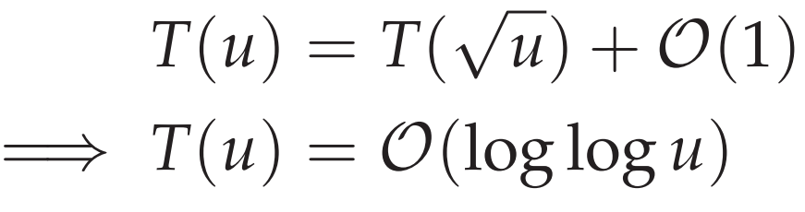
4. Maintain Min and Max
We store the minimum and maximum entry in each structure. This gives an O(1) time overhead for each Insert operation.
SUCCESSOR(V, x)
1 i = high(x)
2 if low(x) < V.cluster[i].max
3 j = Successor(V.cluster[i], low(x))
4 else: i = Successor(V.summary, high(x))
5 j = V.cluster[i].min
6 return index(i, j)

Slide 27
5. Don’t store Min recursively
The Successor call now needs to check for the min separately.
if x < V.min : return V.min
INSERT(V, x)
1 if V.min == None
2 V.min = V.max = x I O(1) time
3 return
4 if x < V.min
5 swap(x ↔ V.min)
6 if x > V.max
7 V.max = x)
8 if V.cluster[high(x) == None
9 Insert(V.summary, high(x))
10 Insert(V.cluster[high(x)], low(x))
If the first call is executed, the second call only takes O(1) time. So
►First Call 1
►Second Call

Slide 28
6. Delete
DELETE(V, x)
1 if x == V.min
2 i = V.summary.min
3 if i = None
4 V.min = V.max = None
5 return
6 V.min = index(i, V.cluster[i].min)
7 Delete(V.cluster[high(x)], low(x))
8 if V.cluster[high(x)].min == None
9 Delete(V.summary, high(x))
10 if x == V.max
11 if V.summary.max = None
12 else
13 i = V.summary.max
14 V.max = index(i, V.cluster[i].max)
► Find new min
If the second call is executed, the first call only takes O(1) time.
So
► O(1) time
► Unstore new min
► First Call
►Second Call
► Now we update V.max

Slide 29
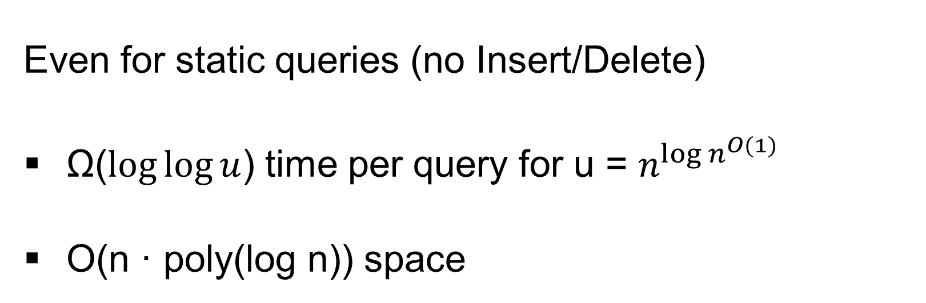
Lower Bound [Patrascu & Thorup 2007]
Even for static queries (no Insert/Delete)
Ω($\log{\log{u}}$) time per query for u = $n^{{\log{n}}^{O(1)}}$
O(n · poly(log n)) space

Slide 30
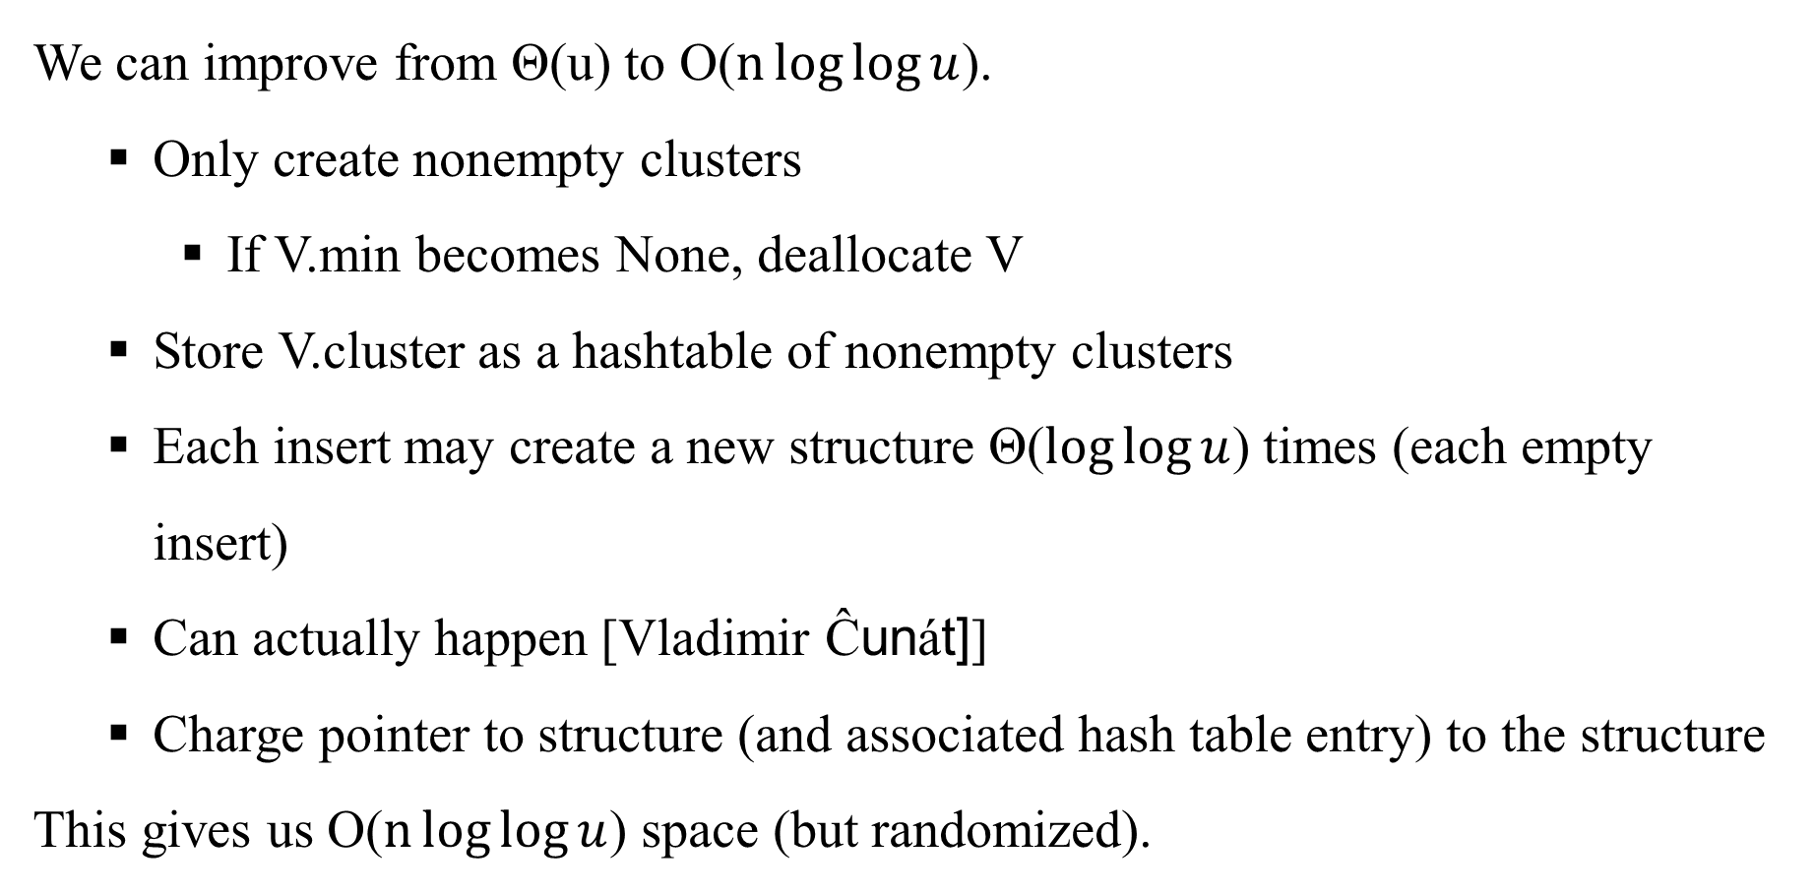
7. Space Improvements
We can improve from Θ(u) to O($n\log{\log{u}}$).
Only create nonempty clusters
If V.min becomes None, deallocate V
Store V.cluster as a hashtable of nonempty clusters
Each insert may create a new structure Θ($\log{\log{u}}$) times (each empty insert)
Can actually happen [Vladimir Ĉunát]]
Charge pointer to structure (and associated hash table entry) to the structure
This gives us O($n\log{\log{u}}$) space (but randomized).

Slide 31
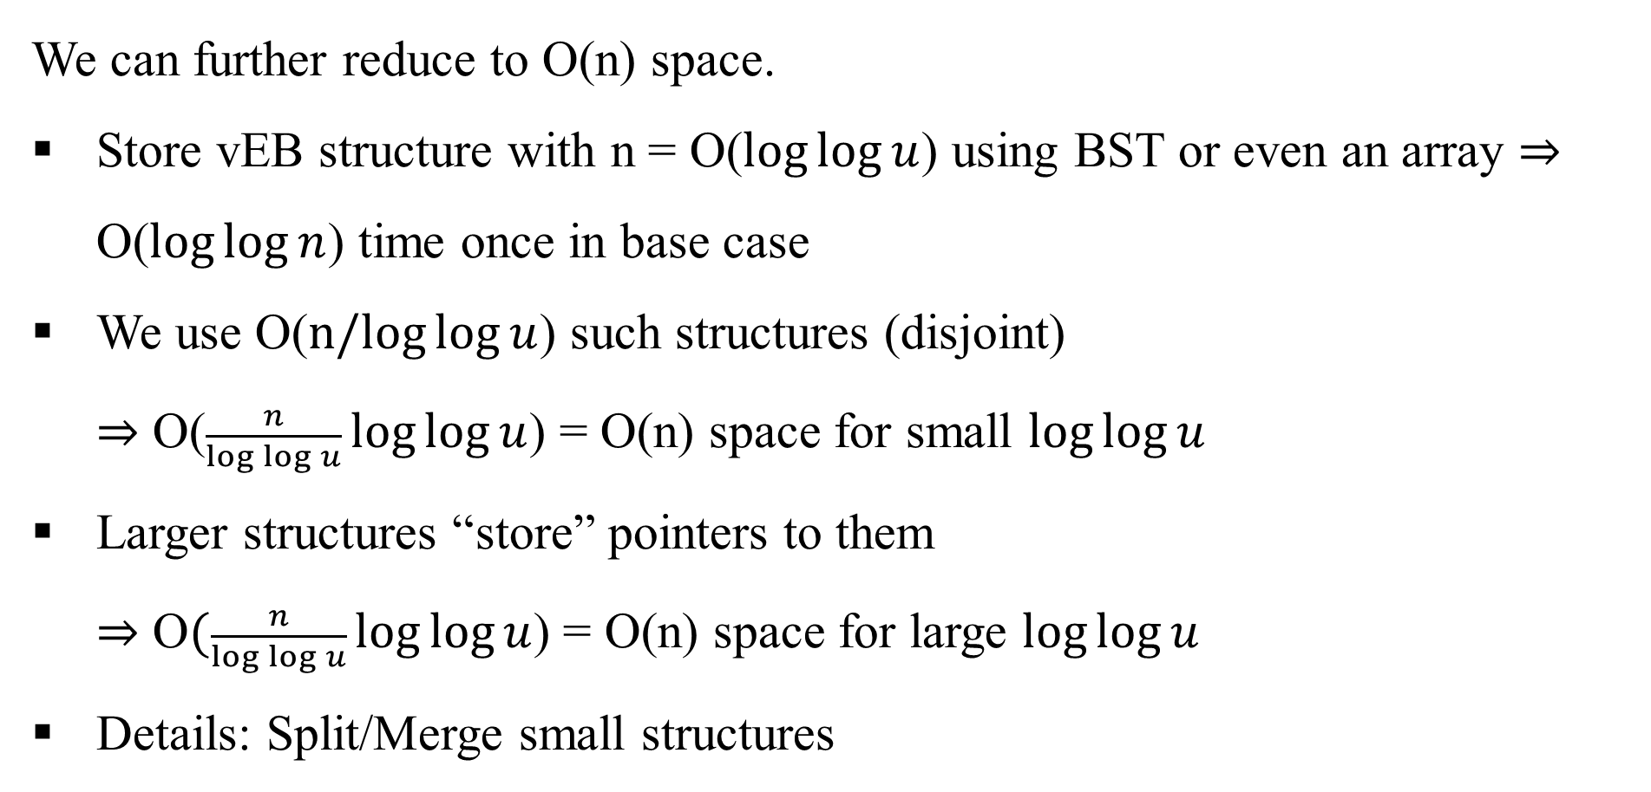
8. Indirection
We can further reduce to O(n) space.
Store vEB structure with n = O($\log{\log{u}}$) using BST or even an array ⇒ O($\log{\log{n}}$) time once in base case
We use O($n/log{\log{u}}$) such structures (disjoint)
⇒ O($\frac{n}{\log{\log{u}}}\log{\log{u}}$) = O(n) space for small $\log{\log{u}}$
Larger structures “store” pointers to them
⇒ O$(\frac{n}{\log{\log{u}}}\log{\log{u}}$) = O(n) space for large $\log{\log{u}}$
Details: Split/Merge small structures

